Slide 1
Book Review Project
By: Sarah Becker

Slide 2
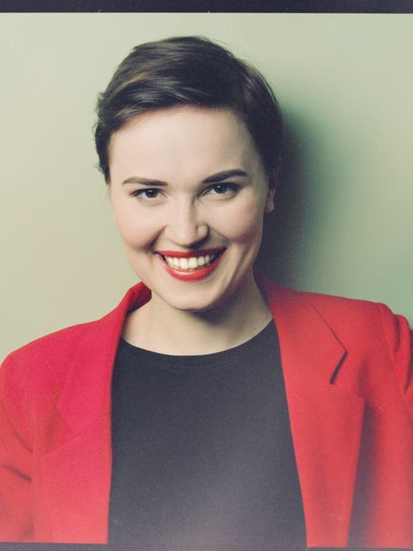
Divergent By: Veronica Roth

Slide 3
summary
Tris Prior moves from Abnegation to Dauntless

Slide 4
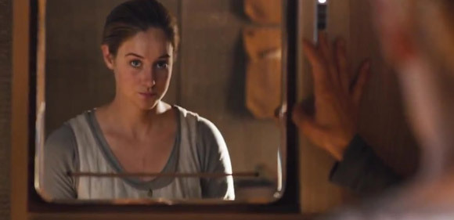
Beatrice is From abnegation

Slide 5
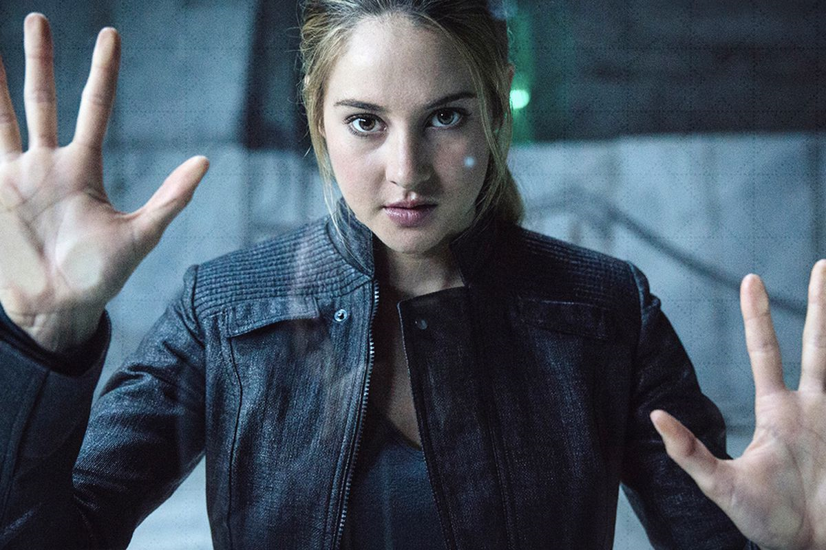
Tris chooses Dauntless

Slide 6
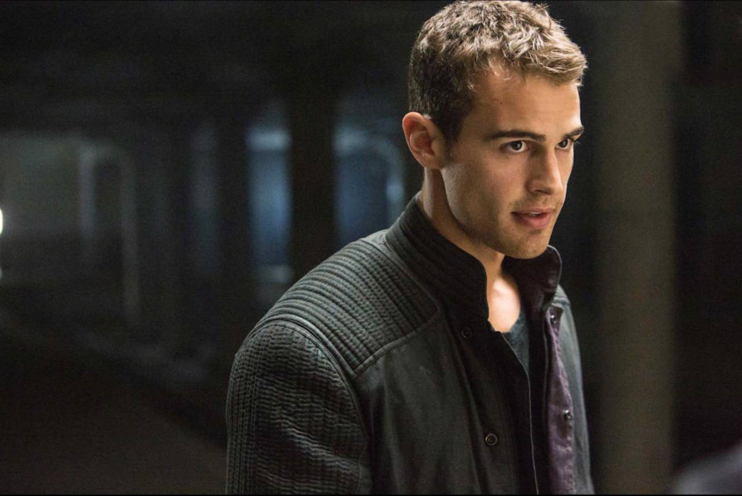
Character that changed the most: Tobias (four)
Tobias: “I am kinder than I seemed in training I promise.” (403).

Slide 7
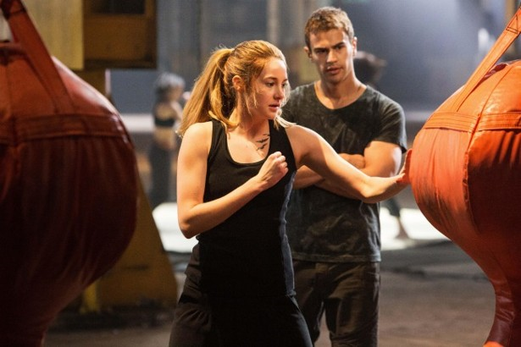
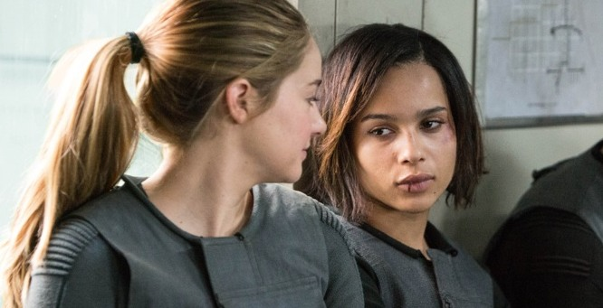
Connection to real life: Stereotypes in society/facing fears
“’I’m Christina,’ she says offering me her hand.” (51).

Slide 8
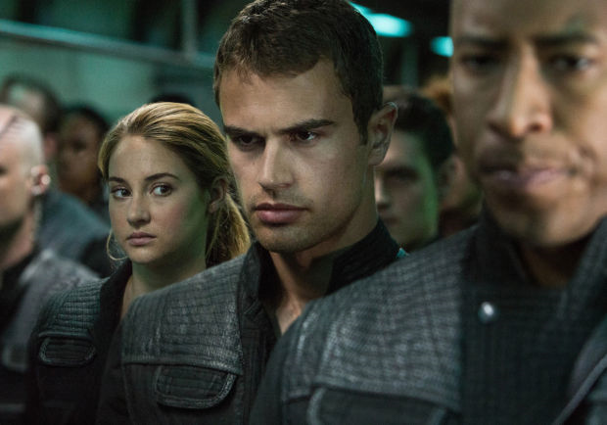
Significance of title: divergent
Tris: ”It’s my choice now, no matter what the test says. Abnegation. Dauntless. Erudite. Divergent.” (23).

Slide 9
Reading level of divergent:
DRA LEVEL: 70 It has a 7th-8th grade reading level. Recommended 9th-12th grade

Slide 10
Book rating/Recommendation
RATE: 9/10 WOULD RECOMMEND READING THIS BOOK

